Slide 1
Power BI
Course

Slide 2

Road Map
Concept : ETL Data - Extract ,Transform, load
Concept : Introduction to Data Model
Concept : measures
Concep : DAX Aggregation , SUM(), COUNT(), COUNTROWS(), MIN(), MAX(), COUNTBLANK(), and DIVIDE()

Slide 3
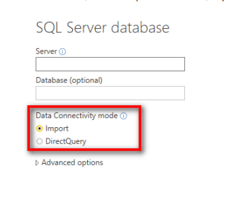
ETL Data - Extract ,Transform, load
Feature | Import | Direct Query
Size | Up to 1 GB per dataset | No limitation
Data Source support | Import data from Multiple sources | Data must come from a single Source
Performance | High-performance query engine | Depends on how fast the network connectivity and data source is as queries are executed in real-time. Only metadata and schema structure are stored on the Data model
Data Change in the underlying data | Not Reflected. Required to do a Manual refresh in Power BI Desktop and publish the report or Schedule Refresh | Power BI caches the data for better performance. So
Data storage in Power BI | Since it is a cached mode
Schedule Refresh | Maximum 8 schedules per day | Schedule often as every 15 mins
DAX expressions | Supports all DAX functions | Restricted to use complex DAX functions such as Time Intelligence functions. However
Calculated Tables | Available | Not supported
https://powerbi.microsoft.com/en-us/what-is-data-modeling/#:~:text=Data%20modeling%20is%20the%20process,between%20those%20bits%20of%20data.

Slide 4
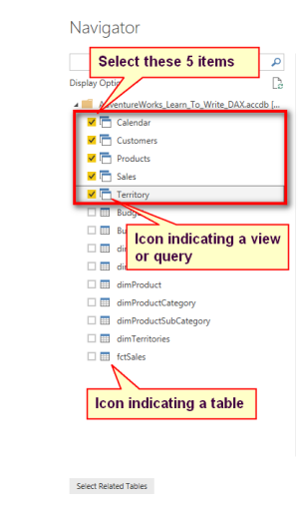
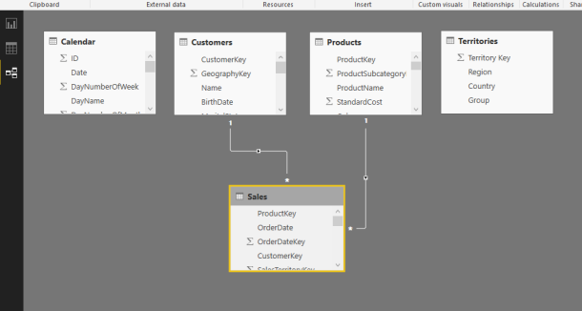
ETL Data - Extract ,Transform, load

Slide 5
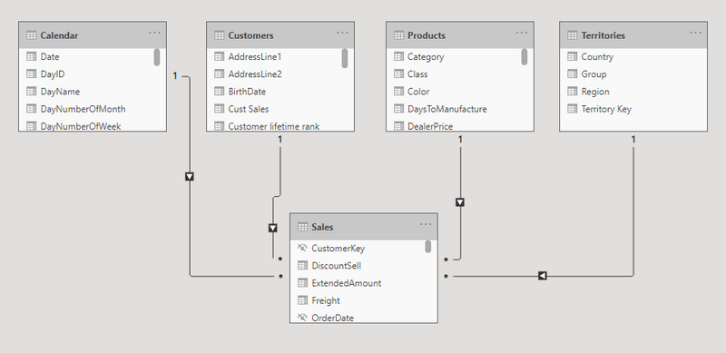
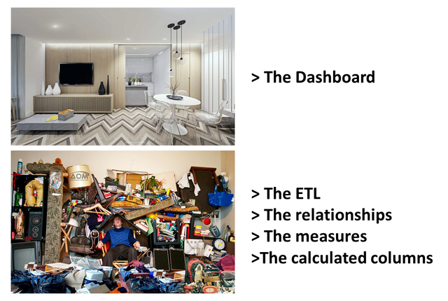
What is data modeling?
Data modeling is the process of analyzing and defining all the different data your business collects and produces, as well as the relationships between those bits of data.
Data modeling concepts create visual representations of data as it’s used at your business, and the process itself is an exercise in understanding and clarifying your data requirements.
https://powerbi.microsoft.com/en-us/what-is-data-modeling/#:~:text=Data%20modeling%20is%20the%20process,between%20those%20bits%20of%20data.

Slide 6
Understand star schema and the importance for Power BI
Star schema is a mature modeling approach widely adopted by relational data warehouses. It requires modelers to classify their model tables as either dimension or fact.
Dimension tables describe business entities—the things you model. Entities can include products, people, places, and concepts including time itself. The most consistent table you'll find in a star schema is a date dimension table. A dimension table contains a key column (or columns) that acts as a unique identifier, and descriptive columns.
Fact tables store observations or events, and can be sales orders, stock balances, exchange rates, temperatures, etc. A fact table contains dimension key columns that relate to dimension tables, and numeric measure columns. The dimension key columns determine the dimensionality of a fact table, while the dimension key values determine the granularity of a fact table.
https://docs.microsoft.com/en-us/power-bi/guidance/star-schema

Slide 7
Understand star schema and the importance for Power BI
Star schema is a mature modeling approach widely adopted by relational data warehouses. It requires modelers to classify their model tables as either dimension or fact.
Dimension tables describe business entities—the things you model. Entities can include products, people, places, and concepts including time itself. The most consistent table you'll find in a star schema is a date dimension table. A dimension table contains a key column (or columns) that acts as a unique identifier, and descriptive columns.
Fact tables store observations or events, and can be sales orders, stock balances, exchange rates, temperatures, etc. A fact table contains dimension key columns that relate to dimension tables, and numeric measure columns. The dimension key columns determine the dimensionality of a fact table, while the dimension key values determine the granularity of a fact table.
Star Schema means the fact table in the heart of the star, and a single relationship to each dimension around it as points of the star.
https://docs.microsoft.com/en-us/power-bi/guidance/star-schema

Slide 8

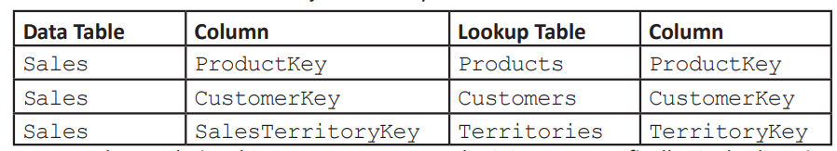
Understand star schema and the importance for Power BI
https://radacad.com/power-bi-basics-of-modeling-star-schema-and-how-to-build-it

Slide 9
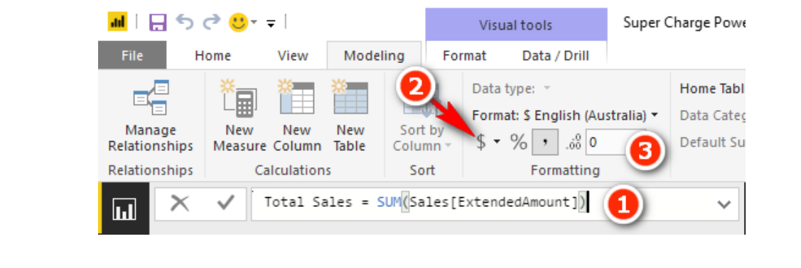

Measures
https://towardsdatascience.com/understanding-explicit-vs-implicit-measures-in-power-bi-e35b578808ca

Slide 10
Measures :DAX Topic: SUM(), COUNT(),COUNTROWS(), MIN(), MAX(), COUNTBLANK(), and DIVIDE()
Writing DAX
[Total Sales] write a new measure that is the total of the sales in the ExtendedAmount column from the Sales table
[Total Cost] Create a measure that is the sum of one of the cost columns in the Sales table. This measure uses exactly the same structure as the measure above, but it adds the cost of the product instead of the sales amount. You can use any of the product cost columns in the Sales table; all the cost columns are the same in this sample database

